Slide 1
Six months industrial training at Ireo Waterfront Vill. Datewal, Ferozepur Road, Ludhiana, Punjab
Name: Jaskaran Singh
Class: B.Tech (D4 CE)
College Roll No.: 100164
University Roll No.: 100370101134

Slide 2
Company Profile
Ludhiana Builders founded in 1991 by Mr. Inderjit Singh & Mr. Jaswinder Pal Singh.
Mr. Mahaveer Singh, retired chief engineer is head of technical team of the company.
Mr. Jaswinder Singh now looks after the work.
Ongoing projects: Construction of Villas and roads at Ireo Waterfront. Construction of Villas and roads at Rajgarh Estates. Construction of SCO’s, parks and roads at Vipul World.

Slide 3
Project Overview
Project area: 500 acres
Client: Ireo
Name of contractor: Mr. Jaswinder Singh (Ludhiana builders)
Executive Engineer: Mr. Amanjot Singh
Sub Divisional Officer: Mr. Rajinder Singh

Slide 4
Facilities required for project
JCB Excavator
Tilted Drum Mixer
Mini Batch Mixing Plants (Gamzen)
Concrete Pump
Vibrators
Tipper truck
Masonry tools and General tools as per the requirements of the project

Slide 5
Introduction to L type villa
Cost of one villa: 3 to 6 crore
Area of one villa: 22m x 9.5m
Concrete used: M25
Minimum strength of steel used: 500 MPa
Building state: Single storey
Starting date of building work: 15th December 2013
Completion date: 10th January 2015
Columns in each house: 5 columns
Thickness of brick walls: 4 inch and 9 inch thick

Slide 6
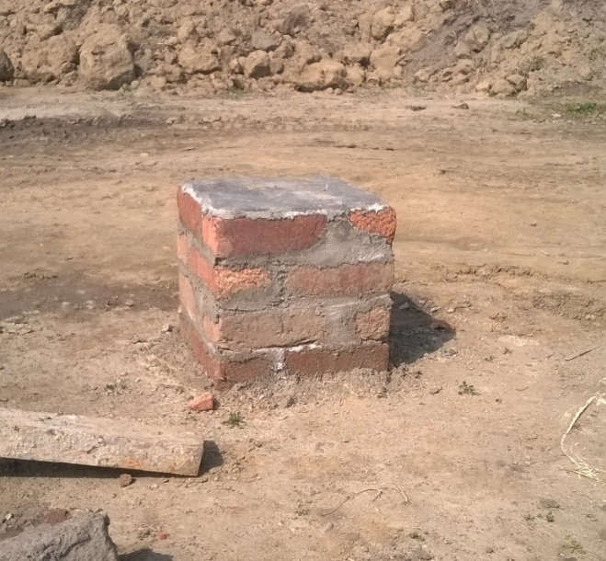
1. Marking and Excavation
Coordinate grid was made by surveying team.
This act as a reference points for boundary of house.
Boundary line was marked by threading these grids and transferring the line to the ground by use of plumb bob.
Excavation was done in excess of 0.5 m from this boundary using JCB excavators till required depth.

Slide 7
2. Marking of footing
Boundary line was marked first, by using plumb bob, on the excavated ground.
All lines on the ground were marked in lime.
By finding the distance of the edges and corners of the footing, from the drawing, boundary for the base of footing was marked by threading and using plumb line.

Slide 8
3. Making base for footing.
Water was sprinkled on the footing and soil compacted by using hand compactor.
Lean concrete was poured on this and was compacted by using hand compactor.
Lean concrete was of proportion 1: 4: 8.
Coarse sand and aggregates retained on 20 mm sieve was used.

Slide 9
4. Details of footing.
Details | Footing F1 | Footing F2
Size near base of footing | 1500 mm x 1500 mm | 1800 mm x 1800 mm
Size near column | 750 mm x 750 mm | 900 mm x 900 mm
Thickness near base of footing | 200 mm | 200 mm
Thickness near column | 450 mm | 450 mm
Size of steel used | 12 mm | 12 mm
Spacing in steel bars length wise | 200 mm | 150 mm
Spacing in steel bars width wise | 200 mm | 150 mm

Slide 10
5. Placement of column and casting of footing.
Lap of the column according to the drawing was made with footing reinforcement.
Column was held in position and made vertical by using plumb bob.
Concrete was poured in the footing and vibrator was used. This was done until required depth was achieved.
Slope of 1 in 3 was given to the footing by use of straight edge.
Footing was finished by use of trowel.

Slide 11
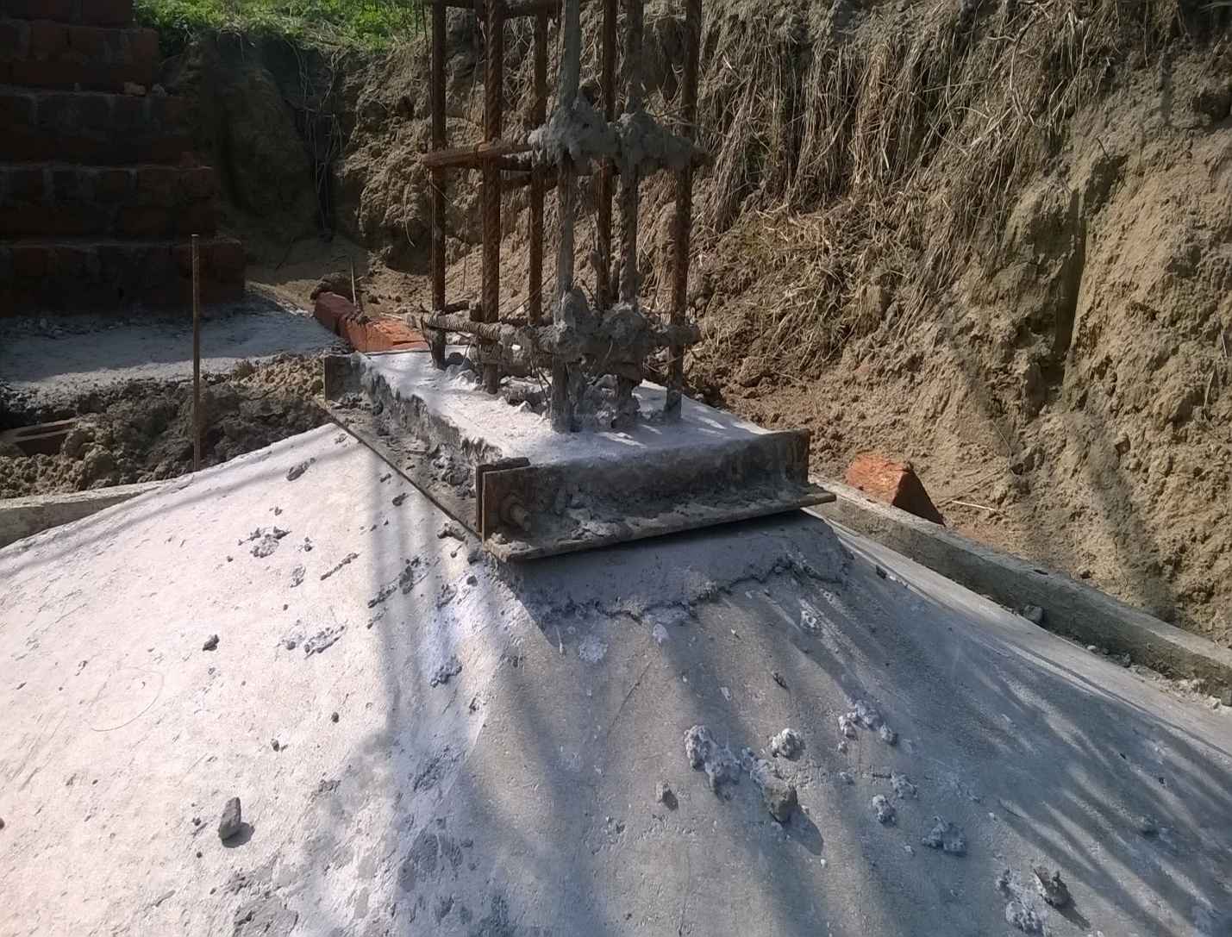
6. Casting of column
Column starter was made first. It was made to make base for column and to keep the column erect. It was made by placing mortar in a mould made of angles.

Slide 12
Details of columns.
Columns were named as C1 through C5 in the drawing.
Details | Columns (C1, C2, C3, C4) | Columns (C5)
Size | 375 mm x 230 mm | 375 mm x 230 mm
Size and number of bars | 4@8mm and 4@12mm | 4@16mm and 4@20mm
Spacing of ties | 100 mm | 100 mm
Clear cover | 40 mm | 40 mm
Grade of concrete | M25 | M25
Proportion of concrete | 1: 1.5: 3 | 1: 1.5: 3

Slide 13
Cover blocks were attached at various points around the column.
Shuttering was erected around the column and made vertical by using plumb bob.
Concrete was poured in the shuttering and vibrator was used.
Shuttering was removed after one or two days.
Curing was done by sprinkling water over the column.

Slide 14
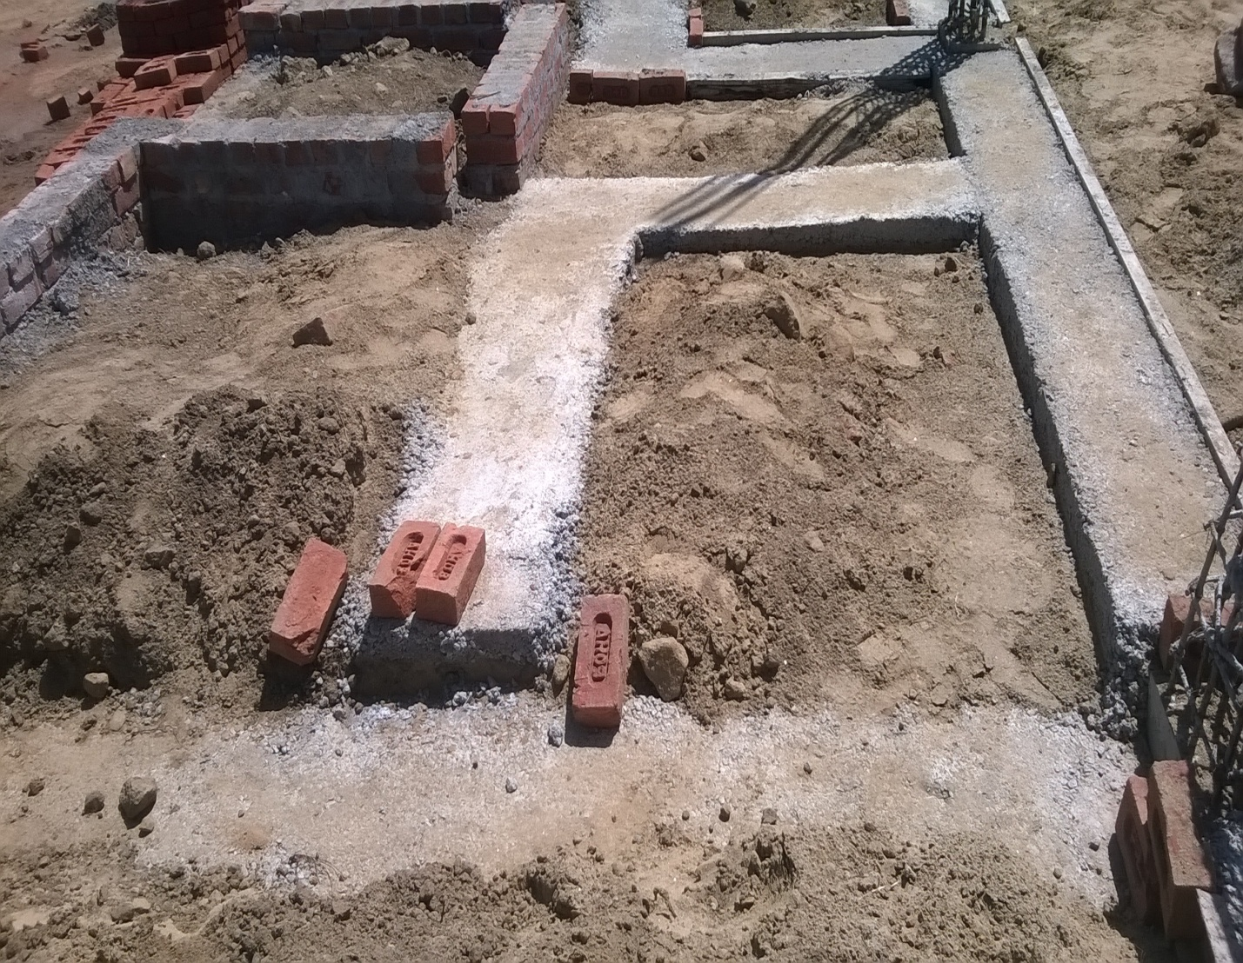
7. Refilling and making base for plinth beam.
After construction till plinth level, soil was dumped by using JCB excavator.
Marking for the plinth beam is done.
Soil is removed from marking, if required in order to achieve required level.
Channels were put on sides, to keep concrete inside the marked area.
Lean concrete of proportion 1: 4: 8 was used with coarse sand.

Slide 15
Details of plinth beam
There were basically two types of plinth beam in the drawings. One was P1 and other was P2.
Details | Plinth Beam P1 | Plinth Beam P2
Width | 230 mm | 230 mm
Depth | 150 mm | 300 mm
Top Reinforcement | 2@10 mm each | 2@16 mm each
Bottom Reinforcement | 2@10 mm each | 2@16 mm each and 1@12 mm
Size of stirrups | 2 legged 8 mm | 2 legged 10 mm
Spacing of stirrups | 150 mm | 100 mm
Clear cover | 30 mm | 30 mm

Slide 16
8. Casting Plinth beam
Cover blocks were put on the beam at bottom and on both sides of the beam.
Plates were put on the sides of the beam. They were held in place by using welds.
Concrete was poured and compacted using vibrator.
Due to large depth of beam, there is no need to provide D.P.C.

Slide 17
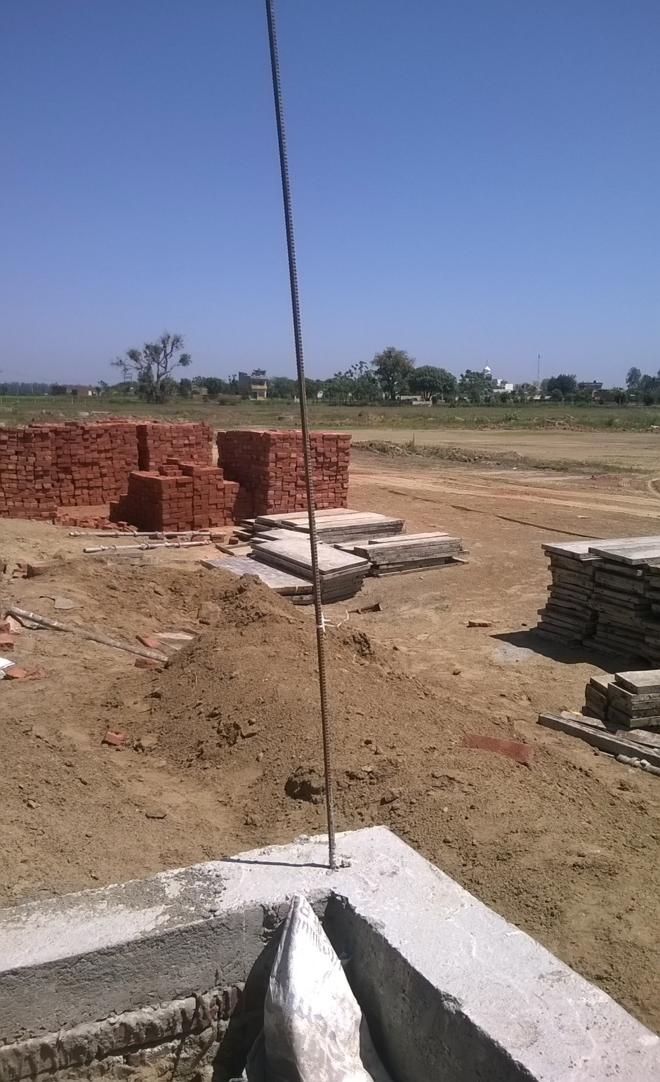
9. Earthquake reinforcement.
A 12 mm steel bar was embedded in the plinth beam, to provide earthquake reinforcement to the walls. This steel would be embedded in the walls.

Slide 18
10. Construction of walls
Walls were constructed on the plinth beams according to the requirement.
Walls were one brick thick walls.
Bricks were laid in english bond.
Mortar made with coarse sand, with proportion 1: 4 was used.
To embed the earthquake reinforcement in the wall, a small pocket is made with bricks around the bar and mortar is filled in it.

Slide 19
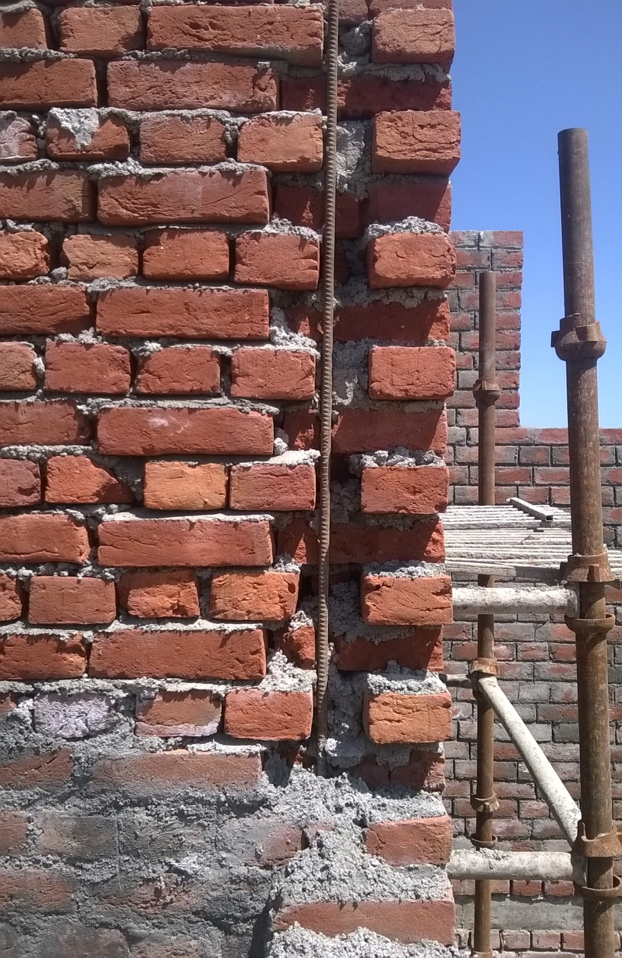
Image showing construction of walls.

Slide 20
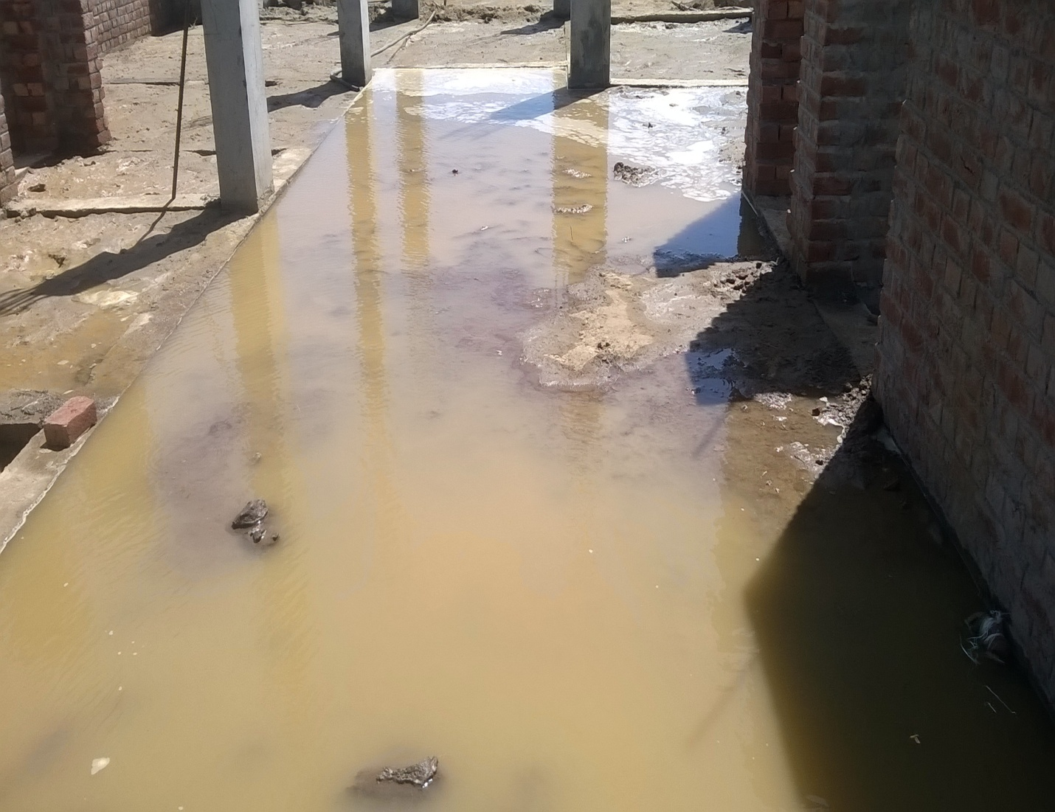
11. Erecting columns and soil compaction
Columns were continued to be constructed, from the plinth level, in similar way as it was done before.
Compaction was done by flooding the area to be compacted with water.
Level of compaction was checked by inserting a stick in the soil. If the stick doesn’t penetrate, compaction is done.

Slide 21
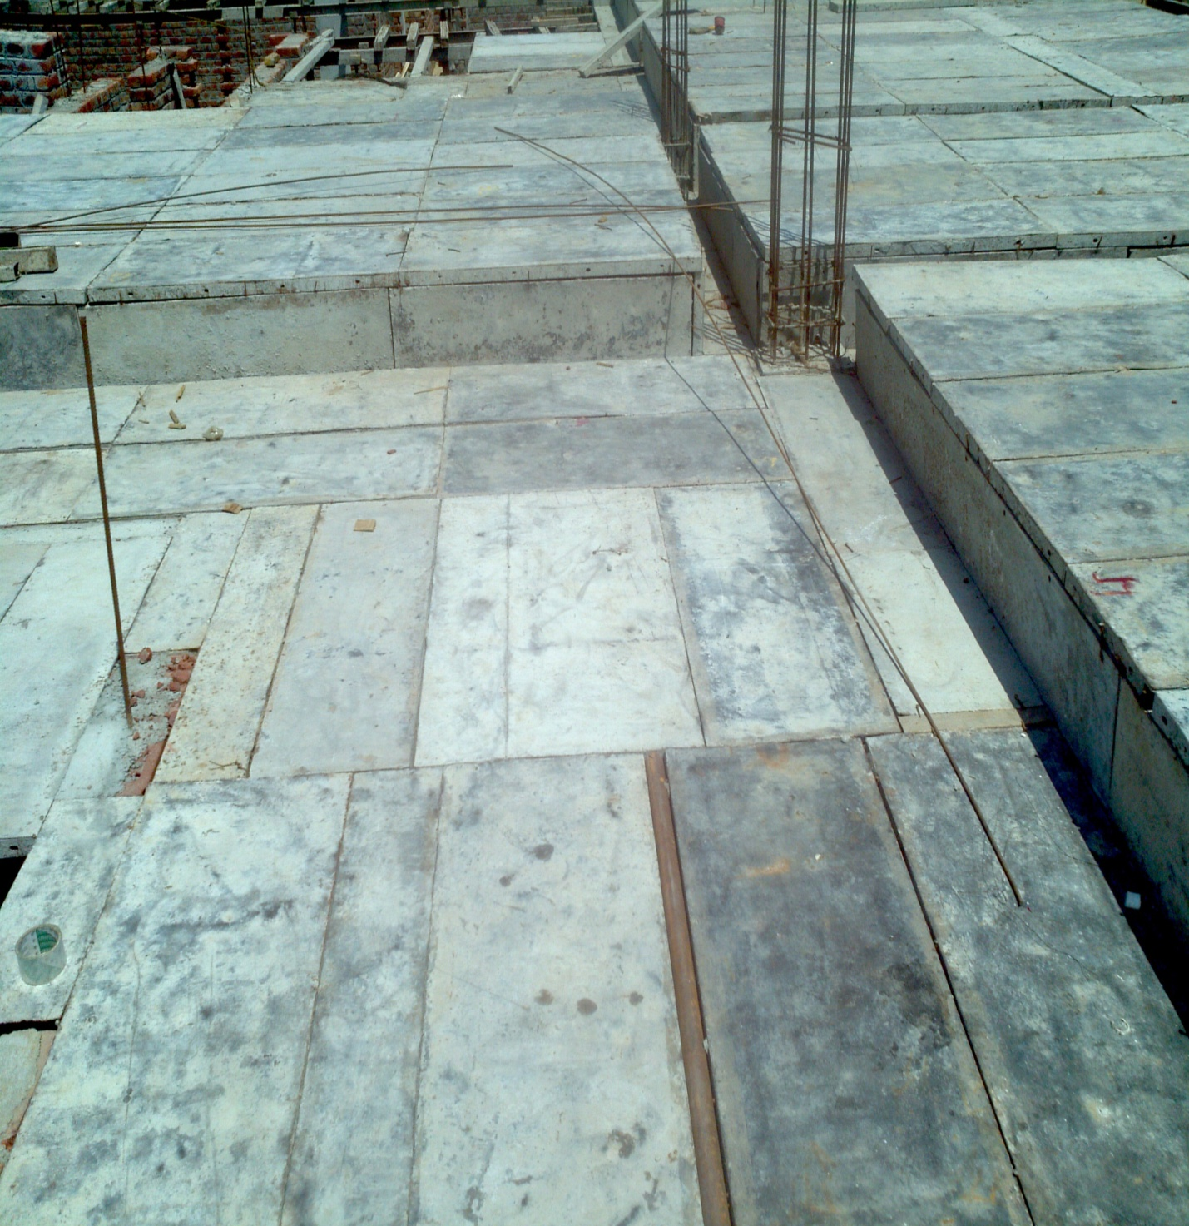
12. Scaffolding and shuttering
Scaffolding was done with steel pipes.
Following things were required Pipes of different sizes. Plate Jack U jack Plates of different sizes
Pipes were erected and bracing was done.
U jack were put at the end and channels were put in them.
Plates were put on these channels.

Slide 22
Reinforcement details of slab
There were two portions of slab marked as S1 and S2 in the drawing. There details are as follows.
Details | Slab S1 | Slab S2
Depth | 150 mm | 125 mm
Diameter of steel used | 10 mm | 10 mm
Spacing of steel bars | 125 mm | 130 mm
Diameter of distribution bars | 10 mm | 8 mm
Spacing of distribution bars | 125 mm | 130 mm
Grade of concrete | M25 | M25
Proportion of concrete | 1: 1.5:3 | 1: 1.5:3

Slide 23
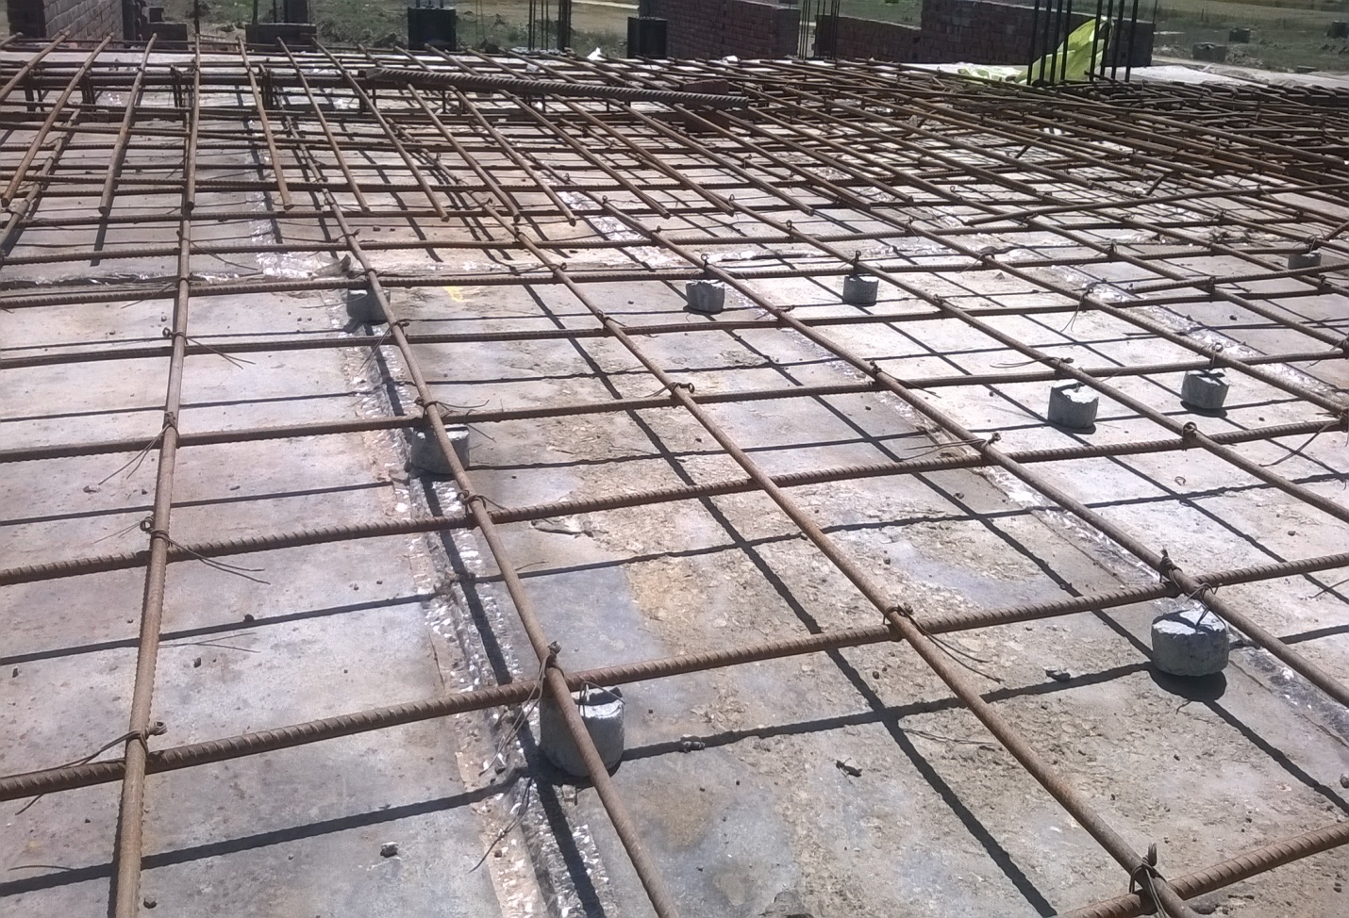
13. Binding steel for the slab
Main steel bars are placed first.
Distribution bars are placed above the main steel bars and tied to it.
Spacing is marked on the main steel bars, distribution bars are tied accordingly.
Cover blocks are tied to the grid after everything is complete.

Slide 24
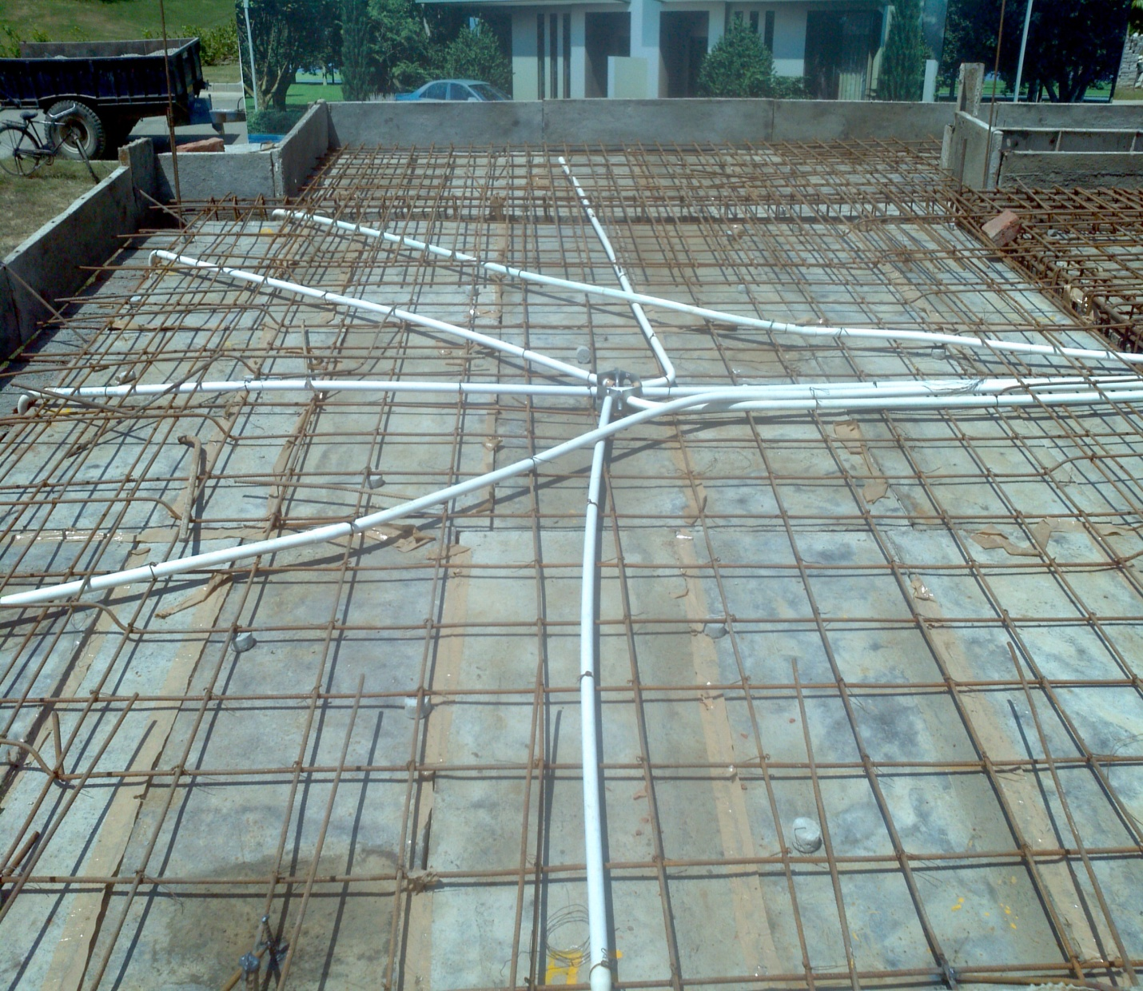
14. Electrical fittings
Electrical fittings, which include fan box, pipes to carry wires, were embedded in the slab.
Pipes were put in place and were tied to the reinforcement.

Slide 25
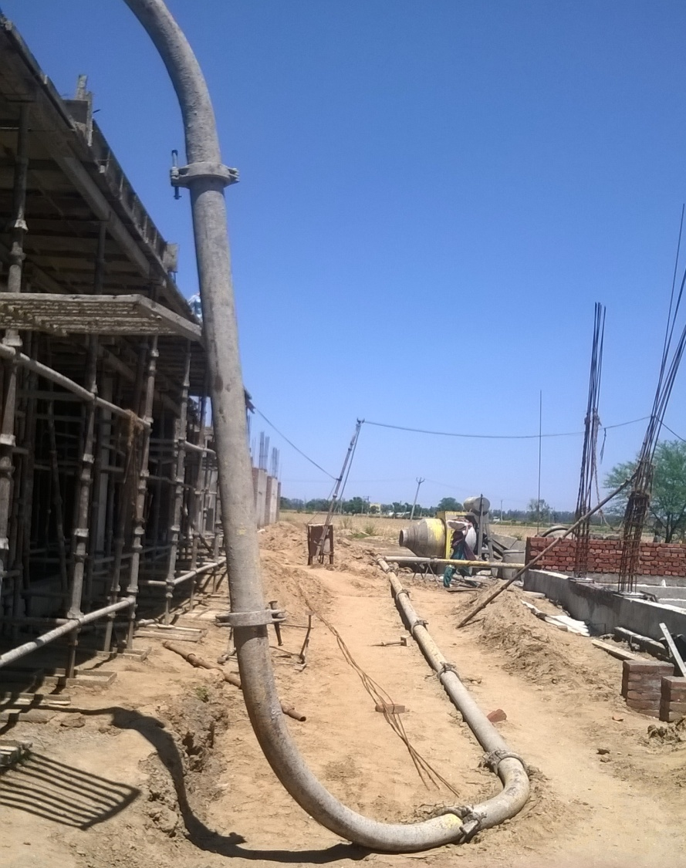
15. Laying pipe.
To transfer the concrete to the slab, concrete pump was used.
Pipe line from the pump to the slab was laid.
Pipe line was either supported by stands or was laid on the ground.

Slide 26
16. Casting of slab
Concrete was prepared in gamzen.
Prepared concrete was transferred directly to the pump, from gamzen.
Concrete was pumped by concrete pump to concrete slab.
Concrete was poured on the slab and was spread evenly by the workers.
Concrete was compacted by using vibrator.
Depth of slab was checked. If required depth was not achieved, concrete was redistributed, until the required depth was achieved.

Slide 27
Concrete being poured by pump

Slide 28
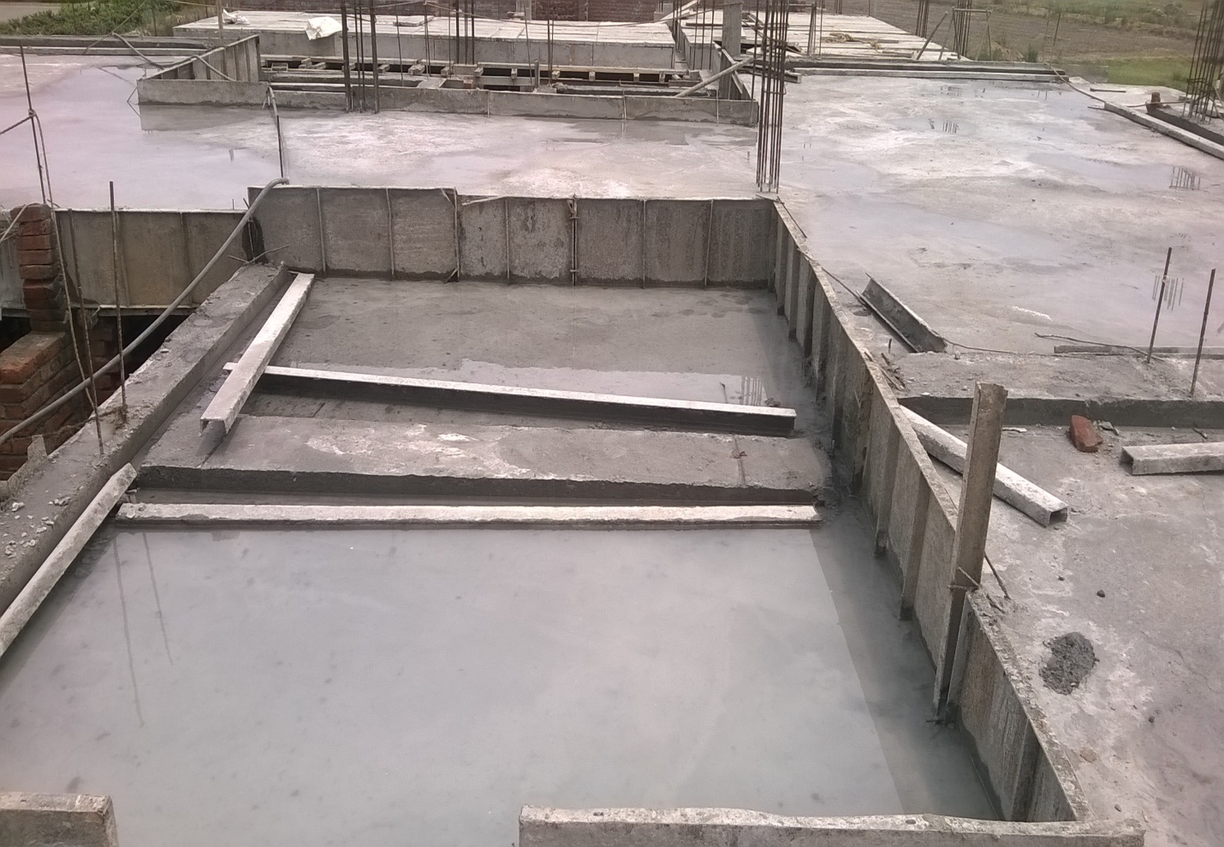
17. Curing of slab
Concrete allowed to set overnight.
Curing was done next day by ponding method.
Water was allowed to stand on the slab for curing.

Slide 29
18. Deshuttering
After 15 days of curing, concrete has gained considerable strength.
Deshuttering of the slab was carried out after 15 days.
Scaffolding was removed first and kept aside.
Plates get stuck to the slab due to bonding action of concrete.
By standing at safe place, a person starts to remove plates one by one.

Slide 30
19. Partition walls
After deshuttering was complete, partition walls were constructed next.
Partition wall were half brick thick.
Mortar of proportion 1: 4 was used.
Lintels were placed above doors and windows.
Lintels were precast at the ground and were placed on the wall. Bricks were laid along and above the lintel as usual.
At the end of the wall, if the bricks won’t fit, brick bats were used.

Slide 31
Partition wall with lintel

