Slide 1
PRESENTATION
SIX MONTHS INDUSTRIAL TRAINING
RGNUL, PATIALA
(From 6th JANUARY 2014 to 25th MAY 2014)
BY: GURSIMRANJEET SINGH
UNIVERSITY ROLL NO. 100370101119
Roll No. 100141

Slide 2
COMPANY PROFILE
NANDA CONSTRUCTION COMPANY
Established in: 1992
Entrepreneur: Mr. Sanjeev Kumar Nanda
Motive of Company: To undertake various business contracts and construction.
Location : Patiala
Various projects accomplished by the company are as follows-
Improvement trust showroom Patiala
ITI Lalru
GuruGranthSahhibBhawan (Punjabi University,Patiala)

Slide 3
OVERVIEW OF PROJECT
AREA OF GROUND FLOOR: 8000 SQ.FT.
ESTIMATED INVESTMENT: 8.5 CRORE
DESIGNED FOR: G+3
DURATION OF PROJECT: 1 YEAR
PROJECT STARTED: AUGUST 2013

Slide 4
INTRODUCTION TO PROJECT
Name Project: Construction of hostel building (boys and girls )
Owner: RGNUL,PATIALA
Main Contractor: Nanda construction company
Structure: RCC Frame structure
Project Supervision: PWD (B&R)

Slide 5
SEQUENCE OF WORK
EXCAVATION
FOUNDATION
COLUMN, BEAM & SLAB
SHUTTERING, CURING & BAR BINDING
DE-SHUTTERING

Slide 6
MATERIAL USED
Cement
Sand
Steel
Bitumen
Aggregates:
1.Fine
2. Coarse
Bricks - used for work are of traditional size 9”*4.5”*3”

Slide 7
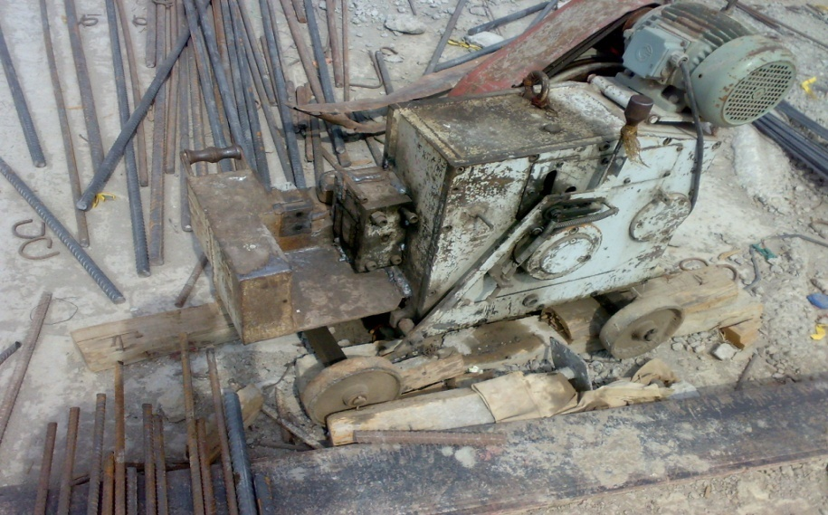
EQUIPMENT USED
Welding set
Concrete mixer
Vibrator
Steel bar cutter

Slide 8
COLUMN
The size of all the columns at site 9.2”x24”(rectangular columns).
Fe-500
Grade of concrete: M-25(design mix).
Clear cover: 1.5”.
Compaction of concrete was done by electrical vibrator.

Slide 10
BEAM
Fe-500.
Grade of concrete used: M-25.
Clear cover: 1”.

Slide 11
SLAB
Fe-500
Grade of concrete used: M-25
Thickness of slab: 120 mm.
Clear cover : 1”
Electric vibrator was used for compaction purpose.

Slide 12
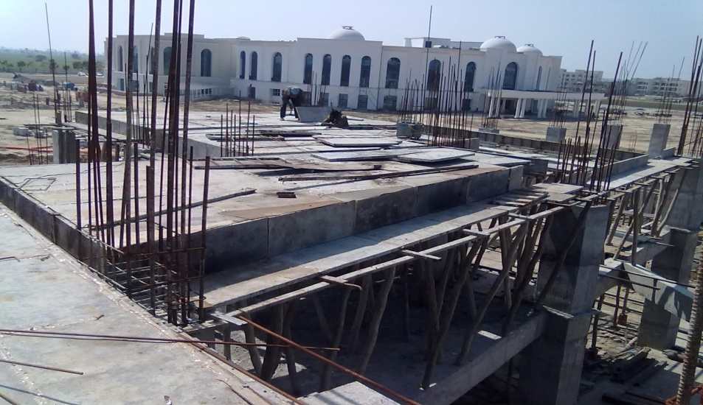
SHUTTERING
Shuttering is of two types:
Steel shuttering
Wooden shuttering
Steel shuttering at site was
supported by timber props (balli’s).

Slide 13
CONCRETING
Grade of concrete:
M25
Concrete is lifted at height with the help of lifting machines.

Slide 14
CURING
Curing is done on slab by two methods :
Sprinkling
Ponding
On columns:
Jute bags
Curing is done for 14 days

Slide 15
DESHUTTERING
Deshuttering or removal of formwork is done after 10 days for slab.
For columns after 48 hours shuttering is removed

Slide 16
TEST PERFORMED
COMPRESSION TEST
BRICK TEST
SLUMP TEST

Slide 17
COMPRESSION TEST

Slide 18
Compression test is performed to determine the characteristic strength of concrete.
Compressive strength is achieved above 90% after 28 days as per concrete mix design.
It gives overall picture of quality of concrete.

Slide 19
SLUMP TEST

Slide 20
Slump test helps to determine the nature of concrete mix.
SLUMP | NATURE OF CONCRETE MIX
NO SLUMP | EXTRA STIFF MIX
FROM 10mm -30mm | POORLY MOBILE MIX
FROM 40mm – 150mm | MOBILE MIX
OVER 150mm | LAST MIX

Slide 21
Recommended slumps of concrete:
TYPE OF CONCRETE | SLUMP VALUE (mm)
Concrete for road construction | 20 - 40
Concrete for slabs and walls that are horizontal | 40 - 50
Normal RCC work | 80 -150
Mass Concrete | 25 - 50

Slide 22
BRICK TEST
Absorption
Compressive strength of bricks
Hardness test on bricks
Presence of soluble salts
Shape and size
Soundness test on brick
Structure of a brick

Slide 23
THANKS

