Slide 1
FINITE DIFFERENCE METHOD
Submitted By:
Mandeep Singh

Slide 2
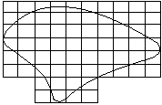
INTRODUCTION The finite difference method has been used for solving numerically some of the difficult problems of structural mechanics. In this approach the body or the system is ‘discretized’ by a mesh of nodal points as shown in figure1 Fig.1. Illustration of discretization for finite difference method

Slide 3
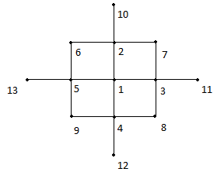
The governing differential equation and the boundary conditions are converted to finite difference form. The finite difference form of the governing differential equation applied to one of the nodal point (of a square mesh) in Fig2 can be shown , Fig 2. Finite Difference Pattern

Slide 4
20w₁ - 8(w₂+w₃+w₄+w₅) + 2(w₆+w₇+w₈+w₉) +w₁₀ +w₁₁ +w₁₂ +w₁₃ = (p/D)λ⁴ where , λ is the step size and D = Eh³ /{12(1-µ² )} The finite difference form of the governing differential equation and boundary conditions are then applied to each of the nodes in turn and this will give a set of linear equations. The resulting equations are then solved for the nodal values of this variable.

Slide 5
Example: Consider a simply supported square plate of size 4m x 4m subjected to a pressure of 6 kN/m² including its self weight. The thickness of the plate is 12cm. Assume E=2x10⁷ kN/m² and µ=0.15 . Solution: The discretization of the plate with 25 nodal points is shown in Fig.3. It may be noted that the additional nodal points outside the plate boundaries 26 to 37 are required for analysis. Since the loading and boundary conditions are symmetric about the two axes, only one quadrant of the plate is considered for analysis. The following boundary conditions are applied: (i) Displacement, w, is zero along the supports

Slide 6
w₁ = w₂ = w₃ = w₄ = w₅ = w₆ = w₁₀ = w₁₁ = w₁₅ = w₁₆ = w₂₀ = w₂₁ = w₂₂ = w₂₃ = w₂₄ = w₂₅ = 0 (a) (ii) Bending moment is zero along the supports (∂²w/∂x²)=0 or (∂²w/∂y²)=0 Using the central difference, (∂²w/∂x²)or(∂²w/∂y²)=0 at a point ’n’ = (w_{n+1} – 2w_{n} + w_{n-1})/2λ² (b) Applying the condition (b) at the points 2, 3, 4, 6,10,11,15, 16, 20, 22, 23, 24 we get the following conditions. w₂₆ = -w₇ w₂₇ = -w₈ w₂₈ = -w₉ w₂₉ = -w₇ w₃₀ = -w₉ w₃₁ = -w₁₂ w₃₂ = -w₁₄ w₃₃ = -w₁₇ w₃₄ = -w₁₉ w₃₅ = -w₁₇ w₃₆ = -w₁₈ w₃₇ = -w₁₉

Slide 7
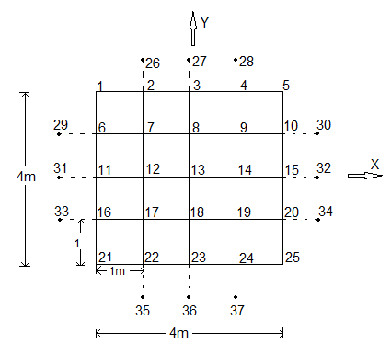
Fig. 3. Discretization of a simply supported plate

Slide 8
Applying the finite difference pattern to the nodal points 8, 9, 13 and making use of the conditions(a) and (c) and symmetry conditions we get, 20w₈ - 8(w₉+w₉+w₁₃) + 2(2w₈) + (-w₈+w₈) = (pλ⁴)/D 20w₉ - 8(w₈+w₈) + 2(w₁₃) + (-w₉-w₉+w₉+w₉) = (pλ⁴)/D 20w₁₃ - 8(4w₈) + 2(4w₉) + 0 = (pλ⁴)/D (d) Simplifying the above equations (d) we get 24w₈ - 16w₉ – 8w₁₃ = (pλ⁴)/D -16w₈ + 20w₉ + 2w₁₃ = (pλ⁴)/D -32w₈ + 8w₉ – 20w₁₃ = (pλ⁴)/D (e)

Slide 9
Solving the above equations, we get w₁₃ = 1.03125 (pλ⁴)/D w₈ = 0.75 (pλ⁴)/D w₉ = 0.5468 (pλ⁴)/D (f) From the given data, we get, D = Eh³/{12(1-µ²)} = (2x10⁷x0.12³)/{12(1-0.15²)} = 2946.3 kNm p = 6.0 and λ = 1.0 Substituing the above numerical values in equation (f) for w_{max} = w₁₃ , we get, w_{max} = 1.03125 (pλ⁴)/D = 1.3125x(6.0x1.0⁴)/2946.3 = 2.1x10⁻³ m = 2.1 mm

Slide 10
The bending moment, M_{x} = -D[(∂²w/∂x²) + µ((∂²w/∂y²)] Applying the central difference for M_{x} at the point 13 we get M_{x max} = -D(1+µ)[(2w₈ – 2w₁₃)/λ²] = -2946.3(1+0.15)[(2x0.75 – 2x1.03125)/1.0²] x [(6x1.0⁴)/2946.3] = +3.8813 kN From the theory of plates solution we get the solution as, w_{max} = 0.00406(pa⁴)/D = (0.00406x6x4⁴)/2946.3 = 2.117x10⁻³ m = 2.117 mm and M_{x} = 0.042192pa² = 0.042192x6x4² = 4.0504 kN

Slide 11
Comparing the values obtained by finite difference method with the standard solution the displacement is very close to the theoretical solution. In general case a finer discretization may be necessary to get the solution closer to the theoretical values. -x-x-x-

